Slide 1

THALEA I –II
Telemonitoring and Telemedicine for Hospitals Assisted by ICT for Life saving co-morbid patients in Europe As part of a Patient personalized care program of the EU.
Ramon Maspons,
Chief Innovation Officer
AQuAS

Slide 2
Introduction to AQuAS
MISSION
  The agency has the mission to contribute to the improvement of the quality, safety and sustainability of the Catalan Healthcare System by means of the generation of relevant knowledge fruit of the analysis of structured information, benchmarking definition, identification of best practices and impact assessment.
  A public company that generates knowledge from the assessment of the healthcare system useful to the main stakeholders of the public Catalan Health System (policy makers, health care managers, professionals and citizens)

Slide 3

Introduction to AQuAS
Innovation
  AQuAS Innovation unit is responsible to strengthen the innovation culture within the MoH and is actively working in the development and adoption of the several procurement instruments: PPI, PCP and Innovation Partnership
  Catalan Health System Observatory
  Assessment
  Innovation
ICT

Slide 4








AQuAS – Key Experience & Strengths –
Some PCP and PPI projects
CSA
Knowledge sharing
PRO4VIP
CSA
PPI
PCP
PCP
PPI
Cervical Cancer Pharmacogenetics
markers
MAGIC
PPI
PPI
PPI
THALEA II
Pacemaker
Ear Plug
Cleaning Device
PCP
PCP
PPI
PPI
Blood Donor Track System
PCP
Mental Health Pharmacogenetics markers
ANTISUPERBUGS
PPI
Adults diapers
Needs Assessment
& Open Technical Dialogue
& Business Case Modelling
ITT definition - Legal
ITT Issued
Bids Assessment
Design & Prototyping
Definition
Execution

Slide 5
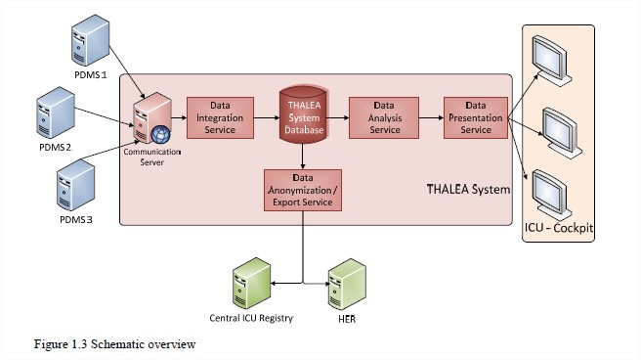
Challenge Description – Identified Demand
Lack of a highly interoperable platform for telemedicine in ICU
Capable to extract data in real time from existing Patient Data Management Systems [PDMS]
Offering decision support in telemedicine centers

Slide 6
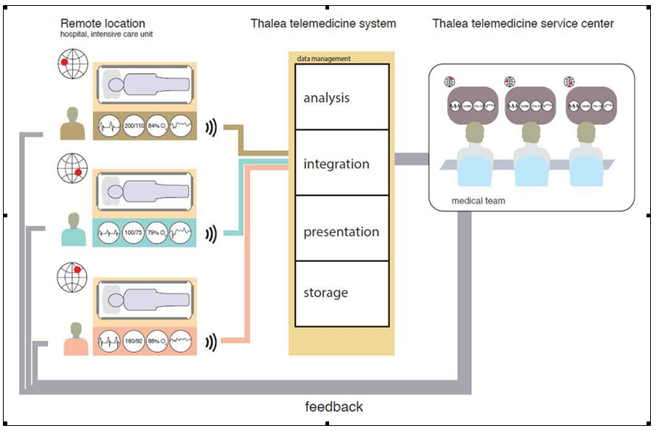
Challenge Description - Goals
Developing software to create a technologically advanced cockpit in which a team of doctors can remotely support and advise various intensive care units:
Monitoring populations of ICU-patients
Support of telemedicine centers
Allows earlier intervention
Standardization ICU-Registry &Big Data
Improvement of compliance and guideline adherence
Higher data quality
SAVING MORE LIVES

Slide 7
Procuring authorities - Consortium
University Hospital Aachen (coordination)
German Ministry of Innovation, Science and Research
Maastricht University Medical Centre+
NL, Agency, Ministry of Economic Affairs
ParcTauli Sabadell University Hospital
Agencia de Qualitat i Avaluació Sanitàries de Catalunya
Hospital East Limburg
Northern Ostrobothnia Hospital District
5 Hospitals with ICU
3 Supporting entities

Slide 8
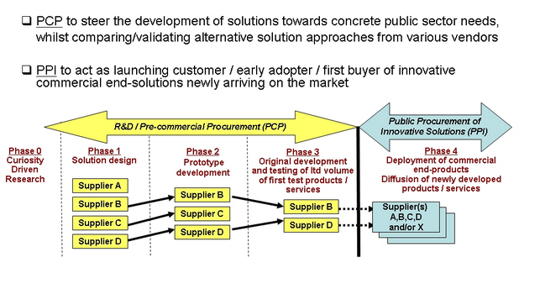
Budget
Effort | Phase 1 | Phase 2 | Phase 3 | Budget
5 Tenderers | 40,000 EUR per tenderer | - | - | 200,000 EUR
3 Tenderers | - | 200,000 EUR per tenderer | - | 600,000 EUR
2 Tenderers | - | - | 375,000 EUR per tenderer | 750,000 EUR
Total | - | - | - | 1,550,000 EUR

Slide 9
Project Status
Project started November 1st 2013
Open Market Consultation:Dec’20, 2013 to Feb’28, 2014
→23 interested companies from 5 different countries
Call for tender: Oct’9 to Nov’25, 2014
Platform availble www.vergabe.nrw.de to submit proposal
→25 formal questions were asked during the open procedure
→7 tender proposals were submited
November’24 2014 the EC intervened to suspend the procedure due to existing uncertainties→Relaunch the call for tender End of march

Slide 10
Key Issues
PCP offers the opportunity for a companies to be provided with R&D technologies
Since PCP focuses on specific identified needs, the chance of exploitation of developed solutions increases.
Intellectual Property Rights will remain completely by the developing companies
The UKA, AZM, FPT, ZOL, and NOHD will acquire the right to use the Intellectual Property Rights developed in the THALEA PCP by companies.

Slide 11
Lessons learned (I)
Carry out all legal issues before publishing a call
Provide tenders with access to documentation an make the delivery process easy
Work closely with local and EC regulations
Respect carefully project schedule

Slide 12
Thalea II - Procuring authorities - Consortium
University Hospital Aachen (coordination)
Maastricht University Medical Centre+
NL, Agency, Ministry of Economic Affairs
ParcTauli Sabadell University Hospital
Agencia de Qualitat i Avaluació Sanitàries de Catalunya
Northern Ostrobothnia Hospital District
Bundesbeschaffung GmbH
4 Hospitals with ICU
3 Supporting entities

Slide 13
Innovative procurement is a Co-creation process requiring a Cultural Change
Lessons learned (II)
Provider – Procurer interaction
Preserving procurement principles
Multidimensional procurement Team
Open specification of tender:
Define the Needs and Boundaries instead of Requirements
Payment based on results
Procurers - clarify which are the expected outputs and outcomes
Providers will procure outcomes instead of solutions!
New approach
Open Market Consultation
Is an essential part of the Co-creation process
Functional analysis of Needs
Develop outcome-based service specifications
with clear built in key performance indicators (KPIs)
Data collection and outputs measurement!
New activities

Slide 14
Lessons learned (III)
Continuation of a PCP
(Example: Thalea2)
Easier to create a strong consortia with aligned needs
Based on the previous project partners.
Preparation phase may be shorter
More focus on execution
Deployment and evaluation
Joint procurement is more feasible
Other PPI
More difficulties to create and manage the consortia partners
Strong leadership is required
Preparation phase requires more resources
Mutual learning, needs alignment for common specifications, Open Market consultation conduction
Execution phase may be affected
Less time for deployment and results assessment
PPI deploying services require flexible common specifications and evaluation
Proximity to end-users is key

Slide 15
Lessons learned (IV)
    Top-down engagement.
      Decision makers must be engaged!
    Political issues may affect procurement plans
    Electoral cycle (with elections every 4 years) may affect procurements!
    Attract operational entities in contact with end-users (hospitals, primary care, social care …)
    They are less affected by political turbulences
    and mission is to be efficient delivering the best services to end-users and know their needs!
    Build and coordinate a strong consortia is key
    Promote the creation networks of public procurers and knowledge partners to work on joint road-maps, and ideas for future proposals. They should introduce new procurers in the call.
    Open Market Consultation activities
    Some local policies do not allow contact procurement-market during the procurement process!
    Outcome based specifications
    Identify the Key Performance Indicators for innovative services is difficult
    Execution must be long enough to evaluate results

Slide 16
Potential target groups for PPI
    Service providers with mid-term plans to improve their efficiency innovating their service portfolio
    either
    Redefining actual services
    Introducing new services
How to reach potential applicants?
Fostering networks of procurers
Promoting the introduction of new procurers in PPI projects
Benefits and effectiveness of such funding
Innovation reach end-users
Multiregional approach should benefit effectiveness of results

Slide 17
That’s all folks !
ramon.maspons@gencat.cat

