Slide 1
Steps during and after a Public Procurement of Innovative Solutions
Barcelona, 31st of May 2016

Slide 2
Public Procurement of Innovative Solutions
Structure of the presentation
Introduction – understanding PPI
Steps for preparing a PPI
Conducting a PPI
The PPI contractual strategy

Slide 3
Public Procurement of Innovative Solutions
1. Understanding PPI
PPI is a public procurement in which public procurers act as a launch customer (early adopter) of innovative goods or services that are:
close or even already available on the market in small quantity, but
not yet deployed on a large scale commercial basis.
PPI does not include the procurement of R&D but may include conformance testing before the purchase of a product to verify if solutions on the market can conform with the deployment requirements.

Slide 4
Public Procurement of Innovative Solutions
1. Understanding PPI
When to use PPI:
PPI should be considered when:
the solution to the public procurers’ needs is closer to the market than in case of a PCP approach;
no R&D is required to meet the procurers’ needs for innovative solutions;
when industrial R&D has already progressed up to the level at which a first batch of end products has been produced and validated through field tests and is already on the market, but hasn’t been scaled up yet to meet the price/quality requirements for large deployment.

Slide 5
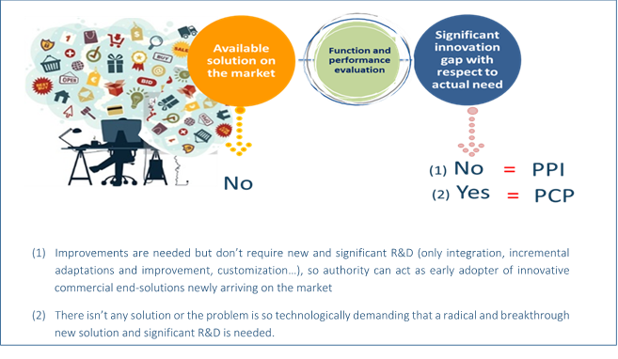
Public Procurement of Innovative Solutions
1. Understanding PPI

Slide 6
Public Procurement of Innovative Solutions
1. Understanding PPI
Legal basis:
TFEU
Public Directives:
Directive 2014/24/EU on public procurement and repealing Directive 2004/18/EC
Directive 2014/25/EU on procurement by entities operating in the water, energy, transport and postal services sectors and repealing Directive 2004/17/EC
Directive 2009/81/EC on the coordination of procedures for the award of certain works contracts, supply contracts and service contracts by contracting authorities or entities in the fields of defense and security
2014 Framework for state aid for R&D&I

Slide 7
Public Procurement of Innovative Solutions
2. Steps for preparing a PPI
Needs identification
Prior art analysis & IPR search
Market consultation
Business case

Slide 8
Public Procurement of Innovative Solutions
3. Conducting a PPI
Drafting the PPI tender documentation
PPI Contract Notice – PIN (published in TED)
PPI Request for tenders (ITT / Tender Regulation)
PPI Procurement Contract (PC)
b) Conducting the procurement procedure
Publication of the contract notice
Selecting suppliers and awarding the PC
Monitoring implementation of the PC

Slide 9
Public Procurement of Innovative Solutions
3. Conducting a PPI – Drafting the PPI tender docs
Description of the procurement object and of the context of the procurement
Technical specifications described in terms of outcome-based requirements/ functional specifications
Description of the procurement process
Description of the legal, economic, financial and technical information (e.g., monetary k value, payment info, language of proposals etc.)
The terms of presentation of the tenderers' offers and tendering requirements
Exclusion, selection and award criteria
Allocation of the weightings based on the importance of the criteria
Notes:
“There is a fine line between making sure the market knows what your requirements are and leaving the door open to different and new ways of meeting those requirements” (Procurement of Innovation Platform)

Slide 10
Public Procurement of Innovative Solutions
3. Conducting a PPI – Drafting the PPI tender docs
Exclusion criteria – concerning the bidders
Selection criteria regard the bidders:
Suitability to perform the professional activity
Economic and financial standing (new provisions on turnover to allow more SMEs to compete)
Technical and professional ability
Public procurers will check whether bidders:
have previous experience with the type of the tendered contract;
have access to or employ personnel with the required educational and professional background;
have access to the necessary technical equipment;
have experience in employing ethical and socially responsible approaches, focusing on sustainability.

Slide 11
Public Procurement of Innovative Solutions
3. Conducting a PPI – Drafting the PPI tender docs
Award criteria regard the tenders, based on MEAT (art. 67 PSD & art. 82 UD):
Identified on the basis of price/cost using a LCC approach
Could include best price-quality ratio, assessed based on criteria linked to the subject matter of the contract:
Qualitative (e.g., technical merit, functionality, accesibility etc.)
Organisation/qualificaiton of staff used for the contract implementation
Environmental
Social
After-sales services / technical assistance etc.

Slide 12
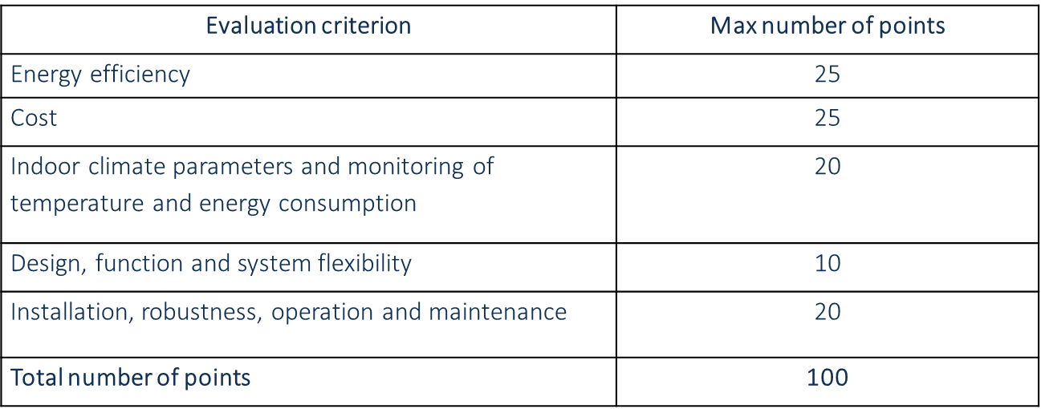
Public Procurement of Innovative Solutions
3. Conducting a PPI – Drafting the PPI tender docs
The following award criteria were applied by the Swedish public procurers for the purchase of heat recycling systems for existing apartment blocks:
Source: http://www.bebostad.se/wp-content/uploads/2013/08/Heat_Recycling_Procurement_eng_invitation.pdf

Slide 13
Public Procurement of Innovative Solutions
3. Conducting a PPI – Drafting the PPI tender docs
an optimum combination of whole life costs, long term costs and quality that meets the users’ requirements will favor innovations which offer best value on the long term, despite looking more expensive or less advantageous on the short term
should be based on the aspects highlighted (by users) during the needs identification phase and subsequently verified during the market consultation
CSR requirements/LCC included in the award criteria

Slide 14
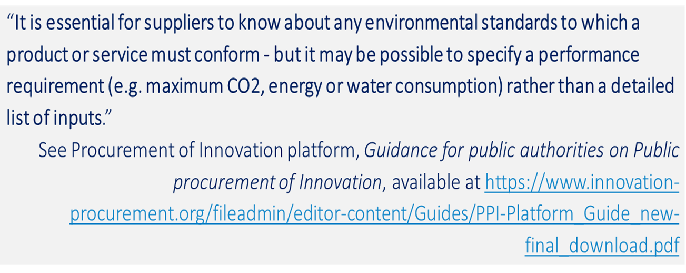
Public Procurement of Innovative Solutions
3. Conducting a PPI – Drafting the PPI tender docs
Technical specifications directly influence the number and quality of tenders
To encourage innovation, they should be:
Based on market consultation outcome
Expressed in terms of outcome / performance based specifications

Slide 15
Public Procurement of Innovative Solutions
3. Conducting a PPI – Drafting the PPI tender docs
Described by reference to standards / GPP criteria
Refer to appropriate specifications that are defined in eco-labels (see the “Coffee Arrest Case” C-368/10)
Not excessively technically descriptive
“There is a fine line between making sure the market knows what your requirements are and leaving the door open to different and new ways of meeting those requirements” (Procurement of Innovation Platform)
Notes:
Art. 42 of PSD and art. 60 of UD include all requirements that the public procurer must remember when drafting the technical specifications (e.g., to publish them upfront in the tender documentation, to ensure they are proportionate to the value and objectives of the procurement, to ensure equal access to the procurement for all potentially interested bidders; to avoid the creation of any unjustified obstacles to competition, to allow equivalent means of proof etc.).
Case C-368/10, European Commission v The Netherlands (the “Coffee Arrest case”): This case regarded tendering procedure for a public contract for the supply and management of drink dispensing machines and of coffee with the Max Havelaar label. The ECJfound that the public procurer has laid down a technical specification incompatible with Article 23(6) of Directive 2004/18 by requiring that certain products to be supplied were to bear a specific eco-label (Max Havelaar label in this case), rather than using detailed specifications in this standard.

Slide 16
Public Procurement of Innovative Solutions
3. Conducting a PPI – Drafting the PPI tender docs
“The technical specifications drawn up by public purchasers need to allow public procurement to be open to competition as well as to achieve objectives of sustainability. To that end, it should be possible to submit tenders that reflect the diversity of technical solutions standards and technical specifications in the marketplace, including those drawn up on the basis of performance criteria linked to the life cycle and the sustainability of the production process of the works, supplies and services.” (R74&R83)
Sustainability included in the tender specifications – 3P
People – social sustainability & ethical considerations (e.g., labor conditions & standards)
Planet – environmental sustainability (e.g., product life cycle analysis)
Profit – economic sustainability (e.g., value for money)

Slide 17
Public Procurement of Innovative Solutions
4. The contractual strategy
Performance clauses – meant to incentivize contractors
could include, for example, environmental / energy performance and other specific commitments related considerations
must be published and set out clearly within the tender documentation in order to ensure full information of the interested bidders
must be linked to the performance of the contract
Monitoring performance clauses
to assess development during project implementation
to assess the progress made by the contractors

Slide 18
Public Procurement of Innovative Solutions
4. The contractual strategy
Examples of performance clauses
Performance payments for key performance indicators (e.g., energy efficiency, minimization of waste, efficient use of resources);
Provide for the possibility to negotiate contract extensions for innovative design alterations, however, conditioned upon mentioning this possibility under the tender documentation;
Guarantees that the contractors having implemented the project will be mentioned in the publicity done for the outcome which meet high performance standards;
Incorporation of a “share gain” clause and/or an “innovation pot” clause, according to which savings on initially planned budget which are triggered by the employment of innovative solutions could be shared between the public procurer and the contractor (VE).

Slide 19
Public Procurement of Innovative Solutions
4. The contractual strategy
VE - Value Engineering clauses
offer the possibility to improve VFM during contract execution of when it becomes clearer which elements of the project increase costs, while not adding commensurate value to the overall performance;
may allow contractors to propose, and public procurers to accept, new state of the art solutions occurring during the contract execution => amendment of an existing contract (art 72 PSD & art 89 UD)
the substantial or material core of the contract must not change;
an improvement for the achievement of the needs would result in savings and the innovation of a service or process.

Slide 20
Stephan Corvers
Ana Lucia Jaramillo
Corvers Procurement Services b.v.
Email: s.corvers@corvers.com; a.jaramillo@corvers.com

